Slide 1
Intervene
Bystander Intervention Workshop
Presenter/Department Name
University
(Optional: Logo)
Notes:
Intro: 2 mins
Hello/Welcome…my name is …. Thank you for being here today/tonight for this new bystander intervention workshop entitled “Intervene”.
During our time together, we are going to explore what it might mean to intervene when someone is in a difficult situation or may even be in danger.
As students, there are times when you may see something that doesn’t seem quite right. It might be obvious or it might be subtle. Sometimes intervening is simple. Sometimes it’s not. You may feel a little awkward but it doesn’t mean it’s not working. Your actions still have an impact; whether in the moment or down the road.
To begin, we are going to watch a set of 7 distinct scenarios in one film. As you watch, please pay attention to how the characters interact with each other as well as how the scenarios are similar and different from one other.
These scenarios are based on real experiences of undergraduate, graduate (and professional) students. Some of these situations occur with greater frequency than others. Like many on our campus, you may have witnessed, directly experienced, or intervened in one or more of these types of situations.
Any of these scenarios may hit close to home for some of us, so we will want to be mindful of this and respectful in the conversation we will have following the film.
During our discussion, please remember that each person’s perspective is valid. We are here to learn from each other, so I invite you to share from your own point of view and to listen for understanding to others. With that, let’s get right into the film. This is “Intervene”…
Click on hyperlink to video: “Bystander Intervention Workshop” on slide CHECK/TURN on CC’s - bottom right hand corner of video screen

Slide 2
Intervene Scenarios
 | Scenario | Person in need of help | Person(s) who intervene | Ind./Group
1 | Stranger and friends intervened in a potential sexual assault | Female | Male & Female | Ind. & Group
2 | Friends intervened in a racial bias situation | Female | Female | Group
3 | Roommate intervened in a hazing situation | Male | Male | Ind.
4 | Acquaintance intervened w/ person feeling overwhelmed by academics | Male | Male | Ind.
5 | Classmates intervened in a sexual harassment/gender bias situation | Female | Male | Group
6 | Friend intervened in an intimate partner violence (emotional abuse) situation | Female | Male | Ind.
7 | Friends intervened in an alcohol emergency | Male | Male | Ind. & Group
Notes:
“You just saw a lot, right? Let’s review the actual scenes.”
Recap the scenarios using the table on the slide.
“Turn to the person next to you and share your initial reaction, thought, feeling, idea, etc..” (1-1 ½ mins)
Let’s hear a few of your reactions: (2 mins)
Who is willing to share with the whole group?
Are there others who had a similar reaction? Different reactions, comments?

Slide 3
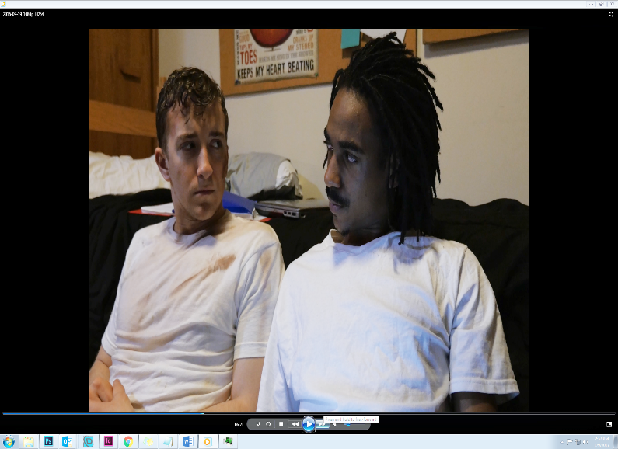
Signs of a Problem
In any of the scenarios, what did the characters see or hear that concerned them?
What can make it hard
to tell if the situation is
serious enough to require
someone to act?
Notes:
Let’s talk for a minute about the signs of a problem: (read first bullet on slide) After a few responses…
Go to the second bullet on slide (click for animation) and read: what can make it hard to tell… After a few responses…

Slide 4
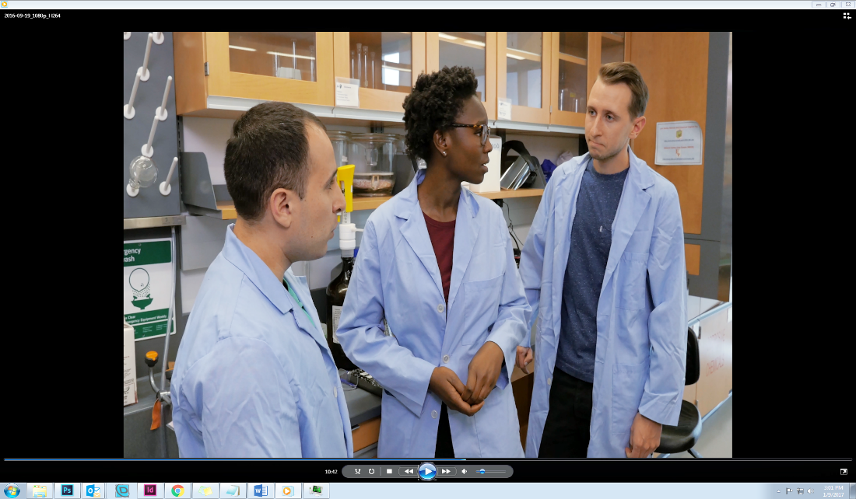
Bystander Emotions
To what extent did the characters feel responsible to say or do something?
What emotions might they
have had to overcome in
order to act?
Notes:
When you’re a bystander in concerning situations, you may have lots of thoughts and feelings about what is happening.
Read 1st bullet on slide: to what extent… Encourage discussion on sense of responsibility with a friend, acquaintance or stranger, as a member of the campus community.
Go to 2nd bullet on slide and read: What emotions… (worry about making it worse, saying the wrong thing, fear of being wrong about the situation, damaging the relationship, etc.)
[Might follow with: “Could you ever see yourself overcoming worry, fear, etc. in a situation to help a friend/ someone?”]

Slide 5
Role of Relationship
Friend
Roommate or teammate
Best friend
Acquaintance
Stranger
Potential Sexual Assault
Bias (racial or other)
Hazing
Academic Stress
Sexual Harassment
Intimate Partner Violence
Alcohol Emergency
Notes:
Let’s spend a minute longer on the Role of Relationship.
To what extent would knowing the person in need of help make it more or less likely that you might act?
And what about hierarchy or power differences in the relationship? Maybe they are older than you or have “status” over you, like being the team captain or an officer in your student organization (sorority)
And is it easier or harder to take action depending on the type of situation? (Click for next animation)

Slide 6
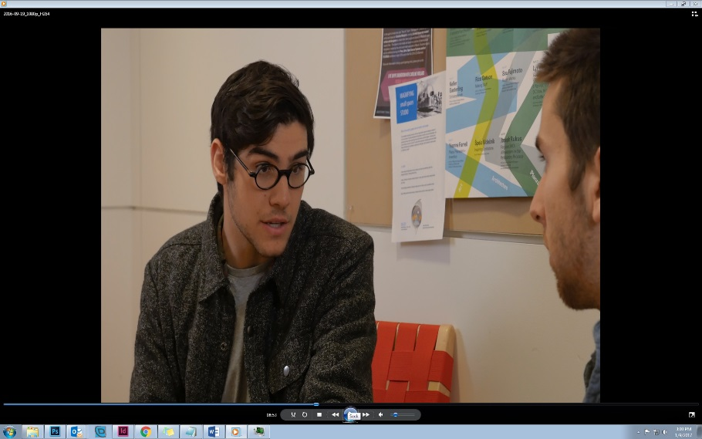
Taking Action
Non-urgent situations
  Listen
  Express concern
  Describe what you observe
  Offer support
  Connect to resources
Urgent/emergency situations
  Don’t assume others will act
  Act with others if possible
  Be direct or distract
  Call for help
Notes:
“In the film, we saw the characters take action in many ways (which we’ve been discussing) both in urgent and non-urgent situations.”
Read slide:
Non-urgent situations
Listen (MH, IPV)
Express concern (SA, Hazing, IPV)
Describe what you observe (Hazing, MH)
Offer support (Racial Bias, Gender Bias/ SH, IPV)
Connect to resources (MH, IPV)
Urgent/emergency situations
Don’t assume others will act (All)
Act with others if possible (SA, Gender Bias/SH, Alcohol Emergency)
Be direct or distract (SA)
Call for help (Alcohol Emergency)
Which of the situations would you consider to be urgent or emergency? What made that alcohol situation an emergency?(Ask group for signs of alcohol poisoning, and fill in the gaps. Go to next slide)
[They might say, the potential sexual assault… if so, we might say something like “yes, this could have ended up being an emergency, but at this stage it was at least an urgent situation and it’s really good the friends acted quickly. There was another scenario however that was already at the life or death, emergency stage. Which one was that?”]

Slide 7
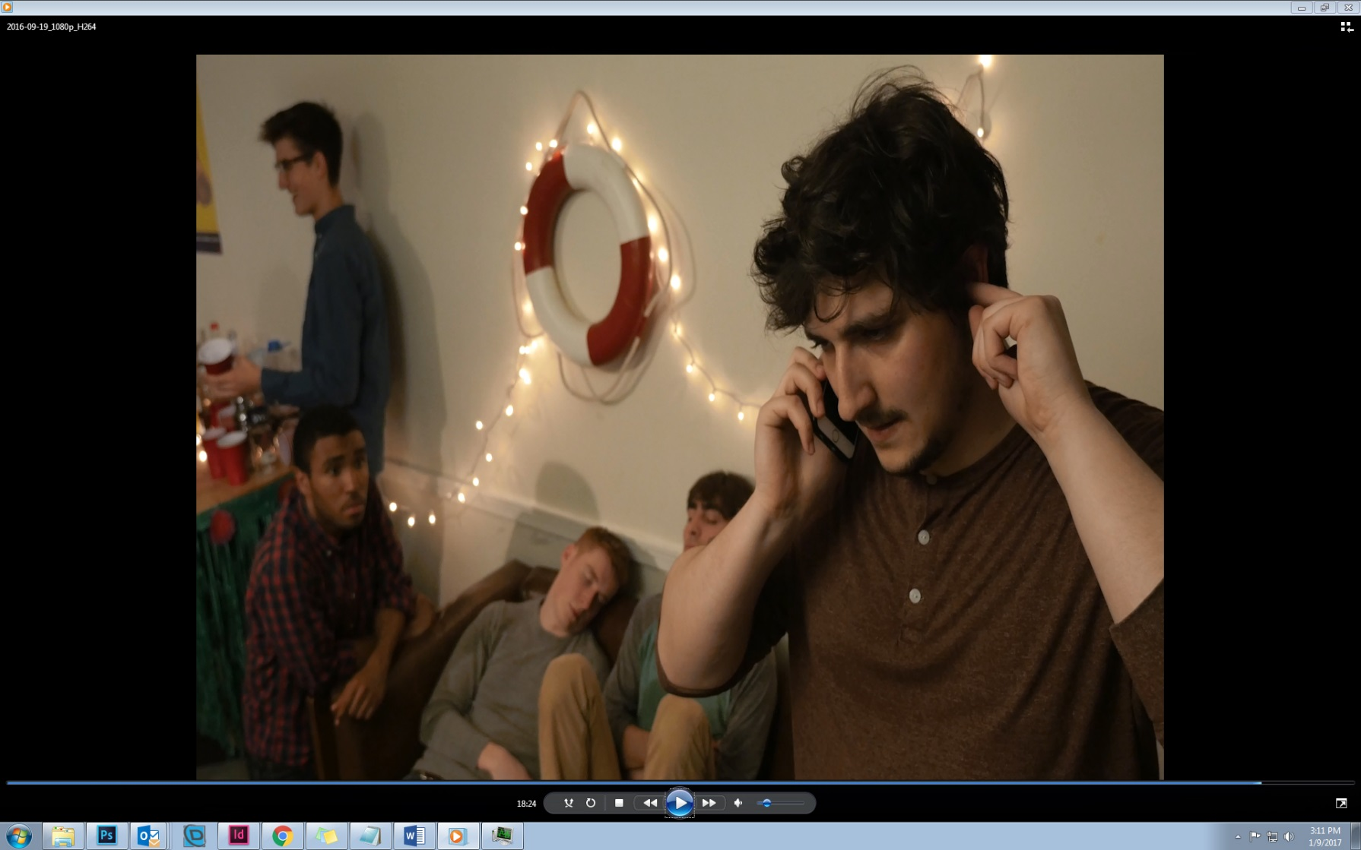
Signs of Alcohol Emergency
A- Alert
    Unable to rouse person or keep awake
    Vomiting while passed out or incoherent
B- Breathing
    Breathing slow, irregular pulse
C- Color
    Skin color “off” or lips bluish,
    cold or “clammy” to the touch
D- Doubt
    Not sure
    Head injury, mixed with other drugs
Notes:
One way to remember the signs of alcohol poisoning: the ABCDs
Read slide

Slide 8

What to Do:
Alcohol or Other Drug Emergencies
Call for help: medical evaluation
  911 Emergency or University Police
Stay with the person until help arrives
Turn the person on their side
Remember the University Good Samaritan Protocol and NYS Law
  You and the ill person won’t get in trouble for underage drinking
  or drug possession
Notes:
Once you recognize the signs of an alcohol or other drug emergency, this is what needs to happen: read the slide
Replace bulleted info on slide with your institutions practices and policies

Slide 9
Camouflage of High Risk Behaviors
Sometimes we choose not to act because we tolerate behaviors we probably shouldn’t
It seems that no one else finds these behaviors troubling; they seem to become a “norm”
This doesn’t make us “bad;” it makes us human
We can begin to remove the camouflage
Notes:
Read slide… then say “We saw this in the alcohol emergency scenario where people just walked over the person passed out on the floor for awhile, acting as if nothing was wrong or out of the ordinary.”
Follow with: “Have you ever seen this(alcohol emergency) at a party?” “What over behaviors have you noticed that get camouflaged here on our campus?” (Offensive comments or jokes– racial, sexist, homophobic, anti-Semitic; Drunk hooking-up; “Minor” hazing. Language contributes to the camouflage too - “that’s so retarded” and “I raped that test”. Can you think of others?)
As a community, we can begin to remove the camouflage by directly addressing these problematic and high risk behaviors when they occur. This can create new campus norms.

Slide 10
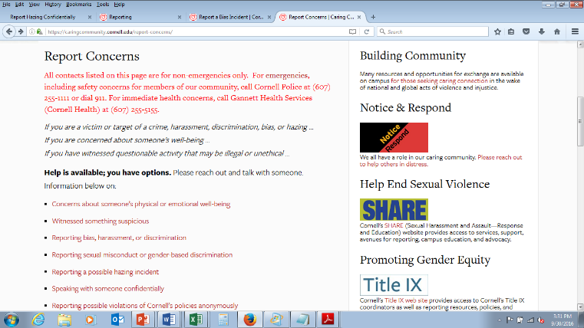
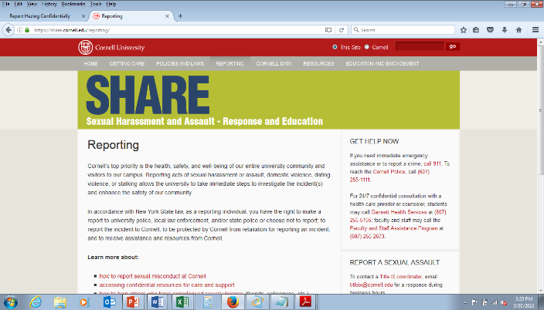
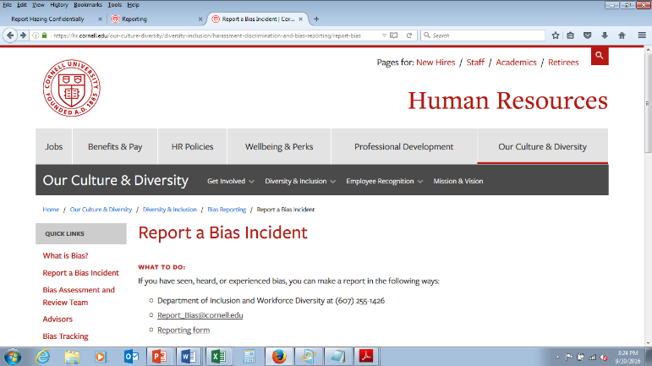
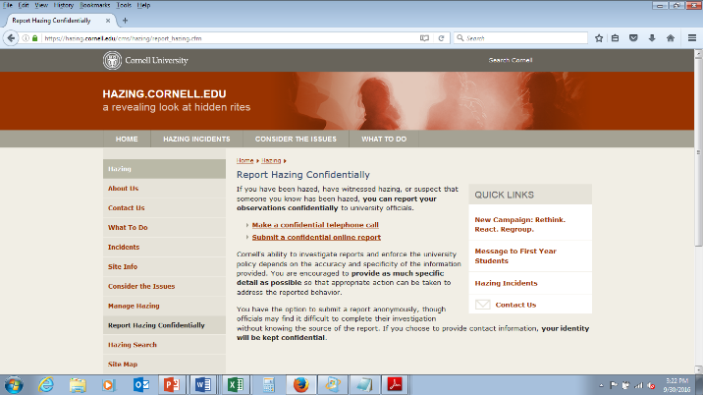
Reporting Concerns & Getting Help
Notes:
Confidential and/or anonymous reporting: Read slide
Top left=caring community website where these three online reporting forms can be found;
Top right= sexual misconduct reporting (sexual harassment, sexual assault, intimate partner violence)
Bottom left = bias reporting
Bottom right = hazing reporting
Replace reporting images on slide with your institutions practices and policies

Slide 11
Cost of Inaction
What might have happened if none of the characters had intervened?
  What could have been the impact on the person in need?
  What could have been the impact on the bystanders? How might they have felt?
Notes:
Let’s just spend a moment considering the “cost of inaction”…
Read Slide and encourage response to the questions

Slide 12
Remember
Sometimes you need to act quickly
Sometimes you can choose when to act
Sometimes you are the only one who can act
Sometimes you can act with others
Doing something may involve taking a risk
Doing nothing may be a greater risk
We are all part of a community
You can make a difference by caring and intervening
Notes:
Remember being a pro-social bystander means…
Click for animations (4x) and read, ending with “We are all part of a community; You can make a difference by caring and intervening”

Slide 13
Thank you!

Slide 14
Intervene (video and workshop) were developed by the Skorton Center for Health Initiatives at Cornell University @ 2016. The information contained in the materials is based on the developers’ best efforts to interpret a body of research and literature, and to translate this into practical considerations. The materials are informational and educational in nature, and are intended to be used as developed and prepared by the Skorton Center for Health Initiatives. The video content is not to be modified, altered or revised in any way. The workshop content is not to be modified, altered, or revised in any way, except for tailoring to your own institutional practices, policies and resources. The Skorton Center makes no representation or warranty express or implied regarding any particular outcome from the use of the materials. Use in part or whole is permitted with attribution to developers.
Notes:
Facilitators: Please read the disclaimer on the slide above prior to facilitating this program.

